Slide 1
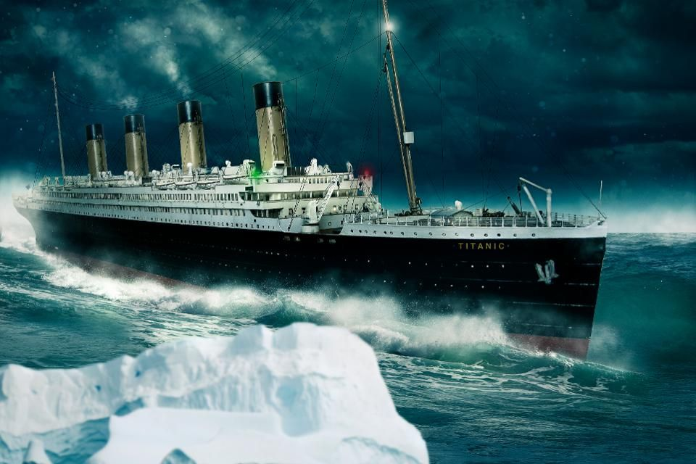

Analyzing Titanic Dataset
By SUDHISH Subramaniam,
Student of VIT VELLORE
2nd Year B-tech : ECE Core

Slide 2
Introduction
On 10 April 1912, the Titanic departed on its maiden voyage from Southampton to New York.
On 14 April 1912, despite warnings of ice fields, the ship did not reduce speed and struck an iceberg shortly before midnight.
The iceberg ripped a long gash in the side and the ship began to flood. Passengers were unaware and joked about the ice found on the deck.
The Captain ordered the lifeboats to be filled and lowered, with women and children first.
The dataset tells us the number of people who survived the tragedy.

Slide 3
OBJECTIVE
The main objective of the machine algorithm is create a model which could predict whether a person could survive the tragedy, by analyzing the parameters.

Slide 4
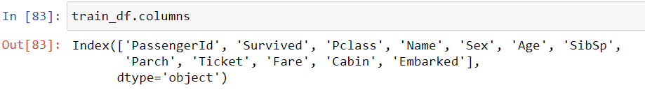
Parameters to determine

Slide 5
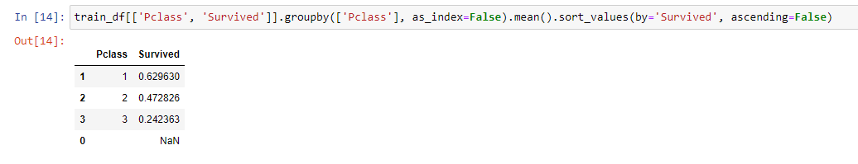
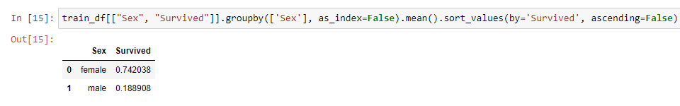
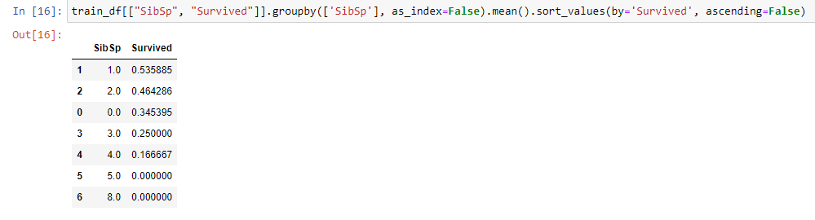
Finding the optimum target columns

Slide 6
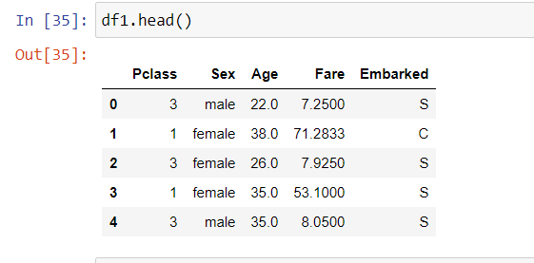
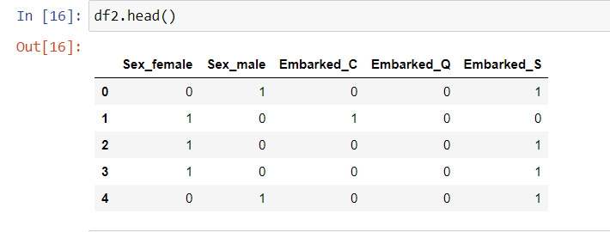
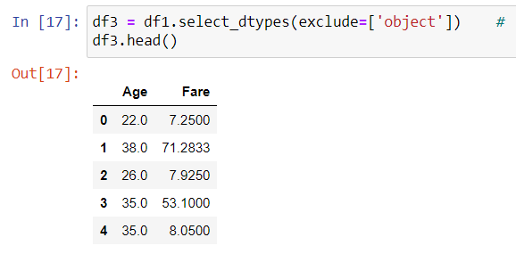
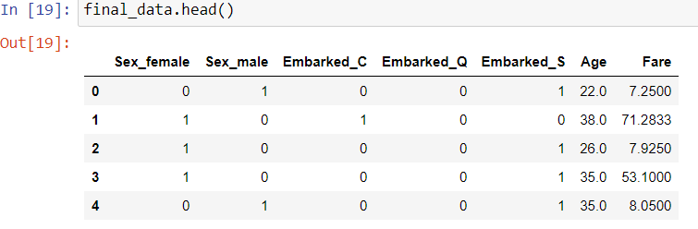
Splitting the dataset

Slide 7
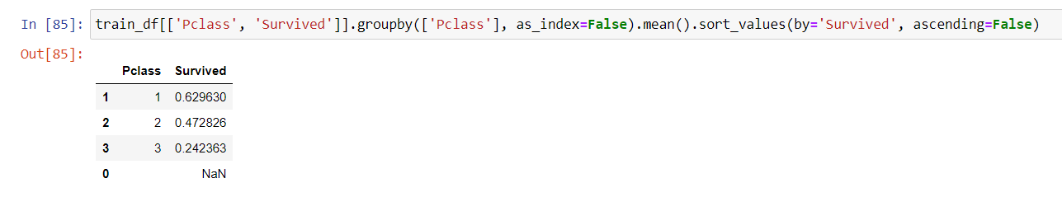
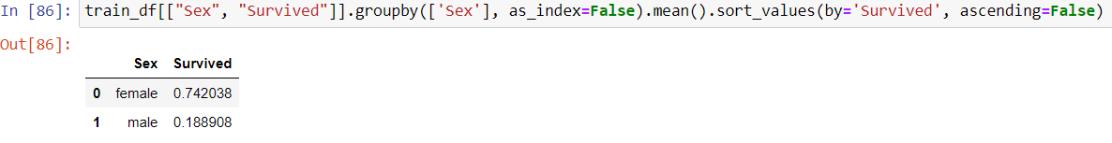
Relation between columns: I

Slide 8
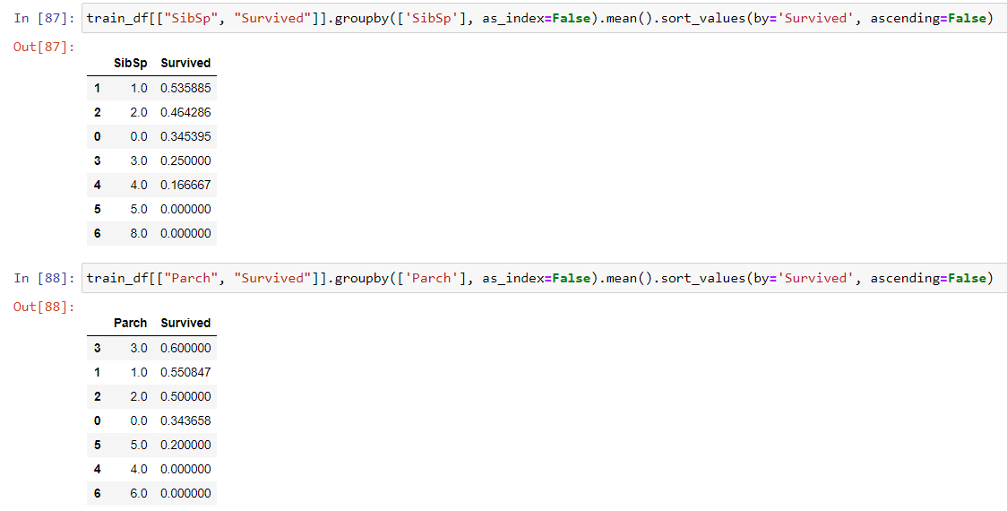
Relation between columns: II

Slide 9
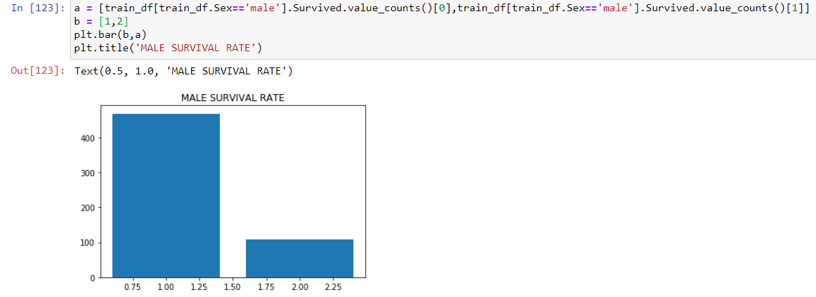
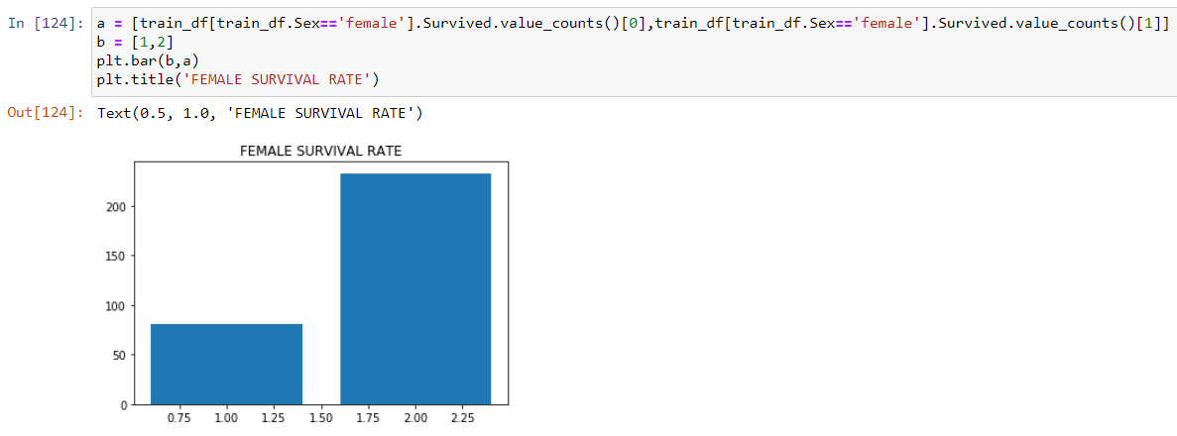
FINDING THE OPTIMUM COLUMN

Slide 10
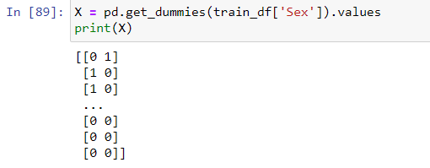
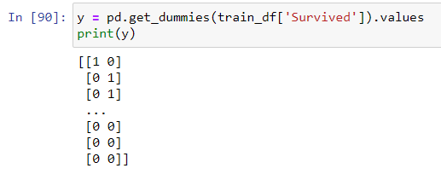
Extracting the required columns

Slide 11
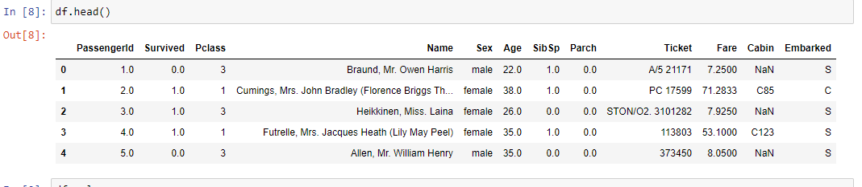
Dataset

Slide 12
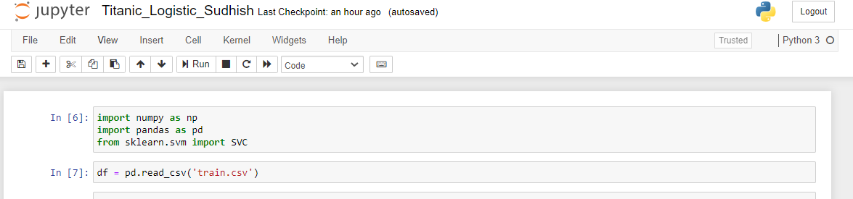
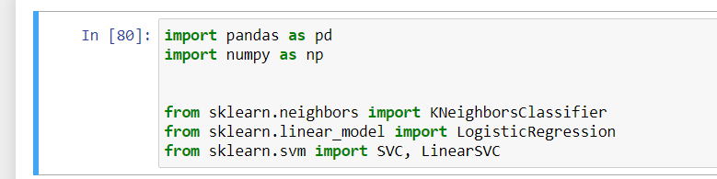
Libraries imported

Slide 13
Logistic Regression
Logistic regression is a statistical model that in its basic form uses a logistic function to model a binary dependent variable, although many more complex extensions exist. In regression analysis, logistic regression is estimating the parameters of a logistic model (a form of binary regression).

Slide 14
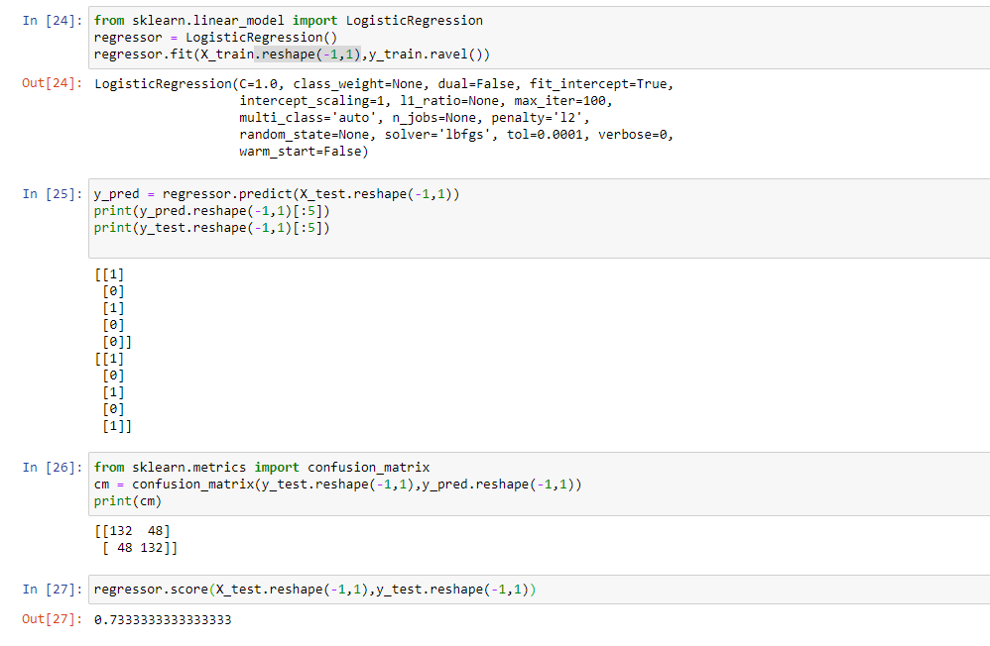
Logistic regression output on our dataset

Slide 15
SVM and svc
Support vector machines (SVMs) are a set of supervised learning methods used for classification, regression and outlier detection.

Slide 16
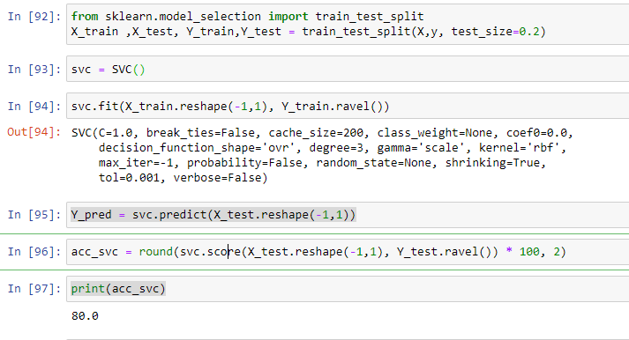
Svc on our dataset

Slide 17
Knn Algorithm
KNN can be used for both classification and regression predictive problems. However, it is more widely used in classification problems in the industry. To evaluate any technique we generally look at 3 important aspects:
1. Ease to interpret output
2. Calculation time
3. Predictive Power

Slide 18
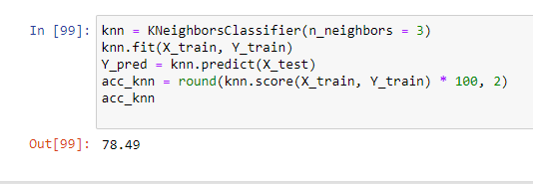
Knn on our Dataset

Slide 19
Converting the dataset into train and test

Slide 20
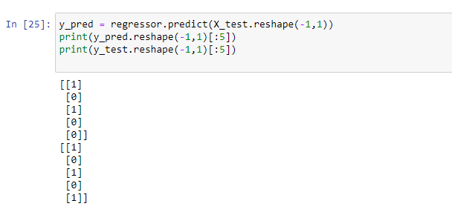
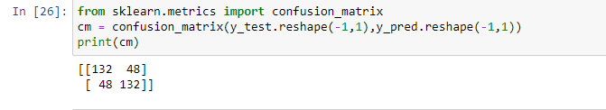
Results of the prediction
Confusion matrix
y_test and y_pred
comparision

Slide 21
Comparing the results
ALGORITHM USED | PREDICTION SCORE
LOGISTIC REGRESSION | 73.333
SVC | 80.0
KNN | 78.49

Slide 22
Conclusion
Variables such as “Passenger Id”, ”Name”, “Ticket”, “Fare”, “Cabin” are removed as they are not effecting the target variable much.
Women, children and first class passengers as well as people with a small family had a better chance of survival.
I am getting a maximum of accuracy of 80% by using the SVC algorithm.

